Slide 1
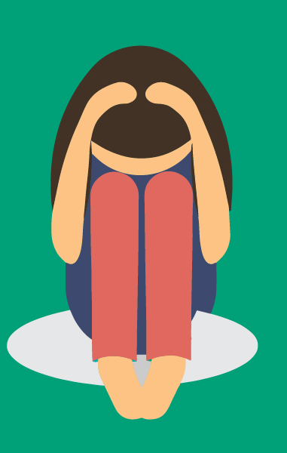
Supporting our kiddos with Anxiety

Slide 2
Did you know?
Anxiety disorders are the most common mental health disorders of childhood and adolescence.
Different kinds of anxiety affect young people at different times in development. Phobias and separation anxiety affect primarily young children; social anxiety develops later, as peer relationships become more important.
Nearly one in three adolescents (31.9%) will meet criteria for an anxiety disorder by the age of 18.
Specific phobia: 19.3%
Social phobia: 9.1%
Separation anxiety: 7.6%
PTSD: 5.0 %
Panic disorder: 2.3%
Generalized anxiety disorder: 2.2%

Slide 3
Anxiety and the brain
Social Media, Hypercompetitive culture, and sleep deprivation all have a negative impact on the brain that can manifest as anxiety.
Social media provide in the moment responses and opportunities to engage in social behavior. It also provides a “filtered lens” that lends a hand to unobtainable body, life style and social behaviors.
Many times kids are involved in so many extra curricular activities (hypercompetitive) they do not have a chance to have down time.
Melatonin, a hormone needed to induce sleep, is released two hours later in average teenagers than in average adults, so they don't even get sleepy until around midnight. When we wake them up at 6:00 a.m., it's like waking an adult up at 3:00 or 4:00 in the morning. That's not great for learning, and it's certainly not great for anxiety and stress.

Slide 4
In the classroom
Many times we tell kids to “calm down” however we have neglected to teach them what that means, what that looks like, and how to do it.
Skills that are often underdeveloped:
Self-regulation
Negative thought stopping
Perspective taking
Executive functioning
Flexible thinking

Slide 5
So what? Now what?
There a few things we can do in our classrooms to help reduce anxiety.
Tackle transitions
Offer “Cognitive Distractions”
Make it Manageable
Apply a Label
Teach the Physical Signs
Help them Initiate
Check in Routinely
Give Private Praise

Slide 6
Examples in a class
Mental Health in Schools

Slide 7
Breaking it down
Tackle Transitions
Offer “cognitive distractions”
Moving from a preferred activity (break/passing) to a non-preferred.
Start class with a quiet period (3 min)
Show a “YouTube” clip to review a concept.
Lead a fun short vocabulary review game.
Instead of giving students a mind break, engage them in something that requires them to not “obsess” over something.
Games like Sodoku
Mad Libs
Hidden Pictures
Writing down the lyrics to their favorite song.

Slide 8
Breaking it down
Make it Manageable
Apply a Label
When kids are given a large project, they will push it off because it seems to be too much and then by procrastinating it compounds the anxiety.
Don’t give full projects- example a science lab.
Break this down into each section of the lab and do it in portions.
“the simple act of applying language to (our fears) helps reengage the thinking parts of our brain.”
Have students “dup” what they are thinking and then crumble it up and throw it away.
Create a list and when a student finishes something make an effort to cross it off.

Slide 9
Break it down
Teach the Physical Signs
Help them Initiate
Many time students are not able to recognize when there are starting to get anxious.
Have students do a “body check”
Ask questions like “is your heart racing, is there too much in your head?
Are they able to gauge how anxious they are (scale 1-10)
Many times students will try and avoid a task they are anxious about (go to the bathroom/nurse).
Preview the content so they know what to anticipate
Have an agenda posted.
Use pre-made sentence starters

Slide 10
Break it down
Check in routinely
Give private praise
Students who are anxious and rely on your support want to know you will be back.
Use a time for them to set and when it goes off you will come back and check on them.
Identify a time you will be back to check in.
Students with anxiety often do not like to have public praise, however that does not mean they don’t like to be recognized.
Ask the student what is the best way for me to tell you how amazing you are doing?
Write a note, check in at the end of the day.

Slide 11
Questions?

