Slide 1
Expulsions 101 and then some…

Slide 2
Expulsion general information
Expulsion matrix

Slide 3
Something has happened now what?
Investigation
Witness statements from all parties involved and any who may have witnessed the offence.
If they cannot write- you can write for them, however be sure to have them sign off what you wrote.
Review the statement- “tell me what happened, and fill this out” is not sufficient.
DUE PROCESS
The student who committed the offense has the right to due process- you have to ask them their side of the story and document that you asked (whether or not they say something). If they refuse to say anything that needs to be documented as well.
Exceptions- if a student has run away from the scene, or is taken into custody, or is injured you are allowed to still suspend but you have to do everything in your power to get their statement and document you attempts.
Citations- if a student is cite be sure to get the citation number and put it in Aeries

Slide 4
Suspension notice
The suspension notice must include the following:
What happened
The location of the incident
Who was involved (do not use student names- you can use student numbers or Student A, B, C, etc.
If it is going to be a recommendation to expel you must included that in the suspension notice: “student is being recommended for expulsion” we can always back out of the expulsion but you cannot come back and add it (unless new evidence is found.)
The suspension notice needs to be given to the parent when they come to pick up the student- have them sign it, if the student is there have them sign it as well.
You must translate all parts into the identified language in Aeries.
Any changes in the suspension notices needs to be added as an amendment and new copy needs to be sent to the family.

Slide 5
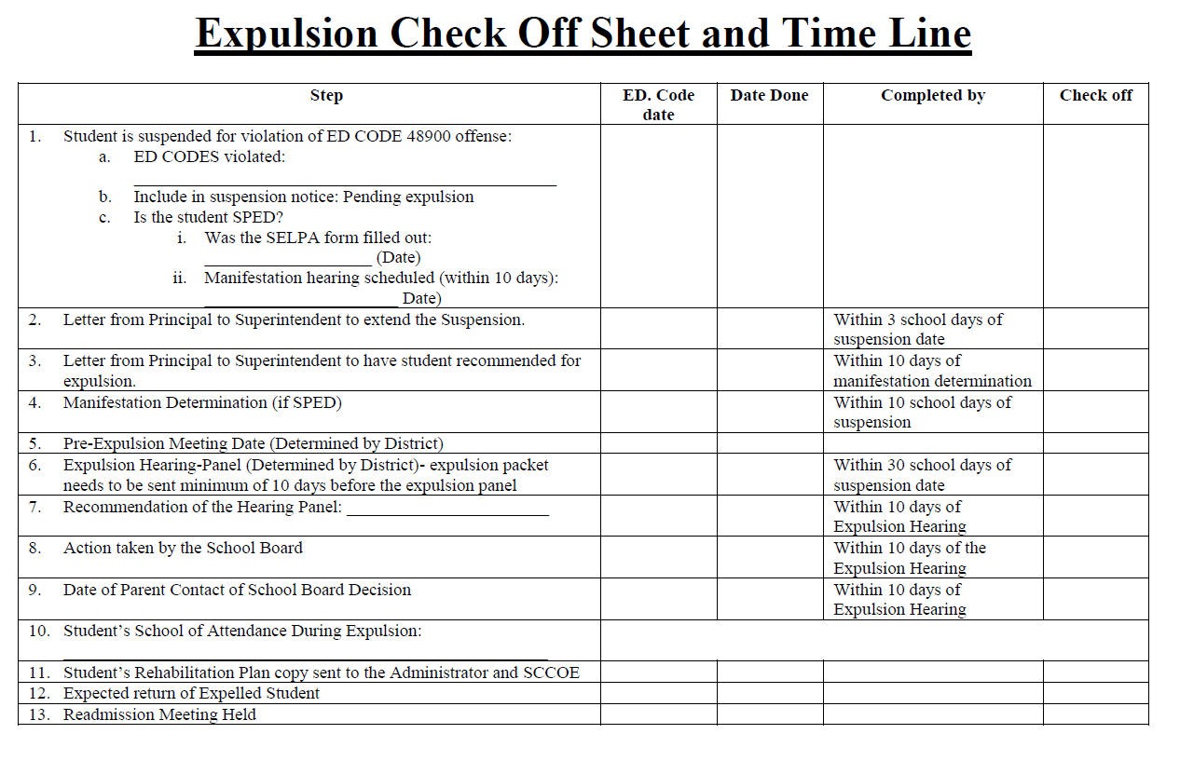
The timeline starts the moment you suspend the student…..
Once you have determined the student committed an expellable offense or has hit their days and you have to recommend the first thing you do (after the suspension notice), send me the two following documents:
Letter to extend suspension
Letter recommending expulsion
Hint- I would print the timeline so that you know what and when you have sent items.

Slide 6
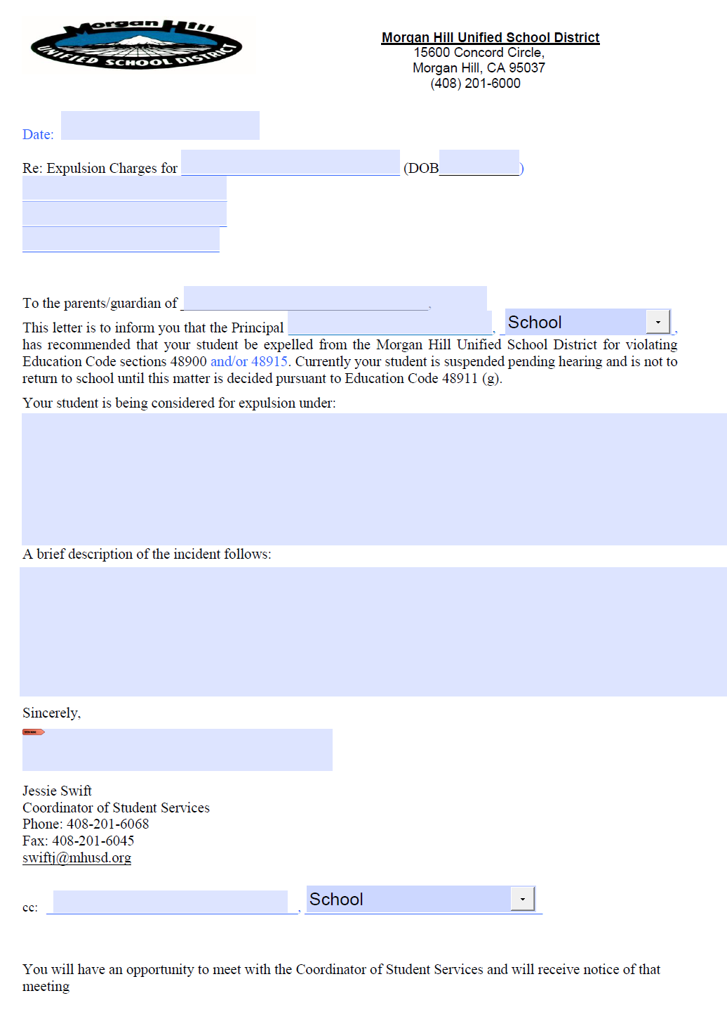
Next…..extend suspension, and notice of expulsion
Once you have sent those over I will process the letters to the family.
Letter to extend suspension
Letter recommending expulsion
NOTE that during this time you have 10 days to complete a manifestation determination if the student is SPED.

Slide 7
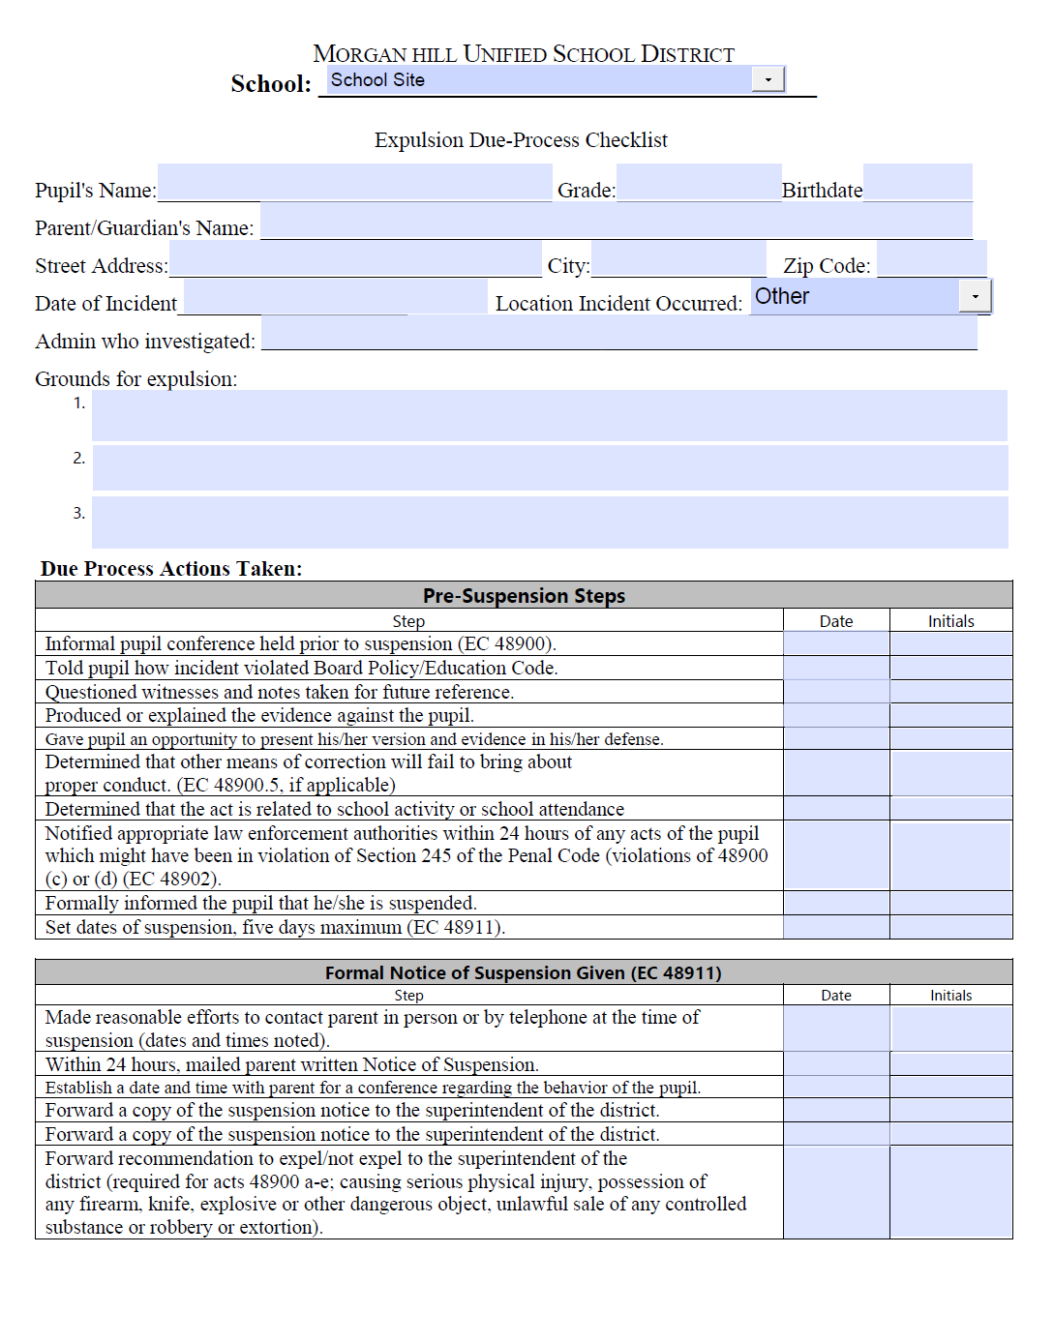
Now comes your part putting together the expulsion packet
Expulsion Check List
All documents you submit need to be translated into the identified language in Aeries.
Student’s face sheet
Student’s attendance
Student’s current grades
Student’s transcripts
Student’s discipline records (cleaned up)
Student’s intervention and counseling record (cleaned up)
Manifestation Determination.
Incident Report
Suspension Notices
Witness Statements (translated) and rewritten on checklist.
Pictures
Police report
IF the student is SPED the psych needs a copy of all of this prior to the manifestation.

Slide 8
Witnesses and witness statements
According to Ed. Code there are couple things around witness, hearsay and cross examination.
Hearsay: Evidence based on statements or documents made by someone else other than the witness. It is evidence not of what the witness knows him/herself, but what the/she has hear from others. Hearsay evidence cannot be tested by cross-examination. There is no opportunity to resolve ambiguities in statement or documents presented. (note admissions by defendant as to conduct, made outside of the hearing, are not hearsay. This is a violation of due process.
What can you do: as an admin you need to submit a statement of everything that happened from start to end, include all conversations, what was said not said, what you saw, etc.
Hearsay evidence:
A statement made at the hearing made by a non witness (i.e. administrator) offered to prove the truth of the matter stated (not admissible in court).
A statement presented at a hearing by the administrator to support a finding fact and is allowable at expulsion hearing (admissible in court).

Slide 9
The five main rules to follow on hearsay
Formal rules of evidence do not apply at student expulsion hearings.
Every expulsion must be supported by at least one piece of direct evidence
No evidence to expel shall be based solely upon hearsay evidence.
There must be live testimony by someone who has a percipient witness.
Unless the evidence meets the criteria for an exception.

Slide 10
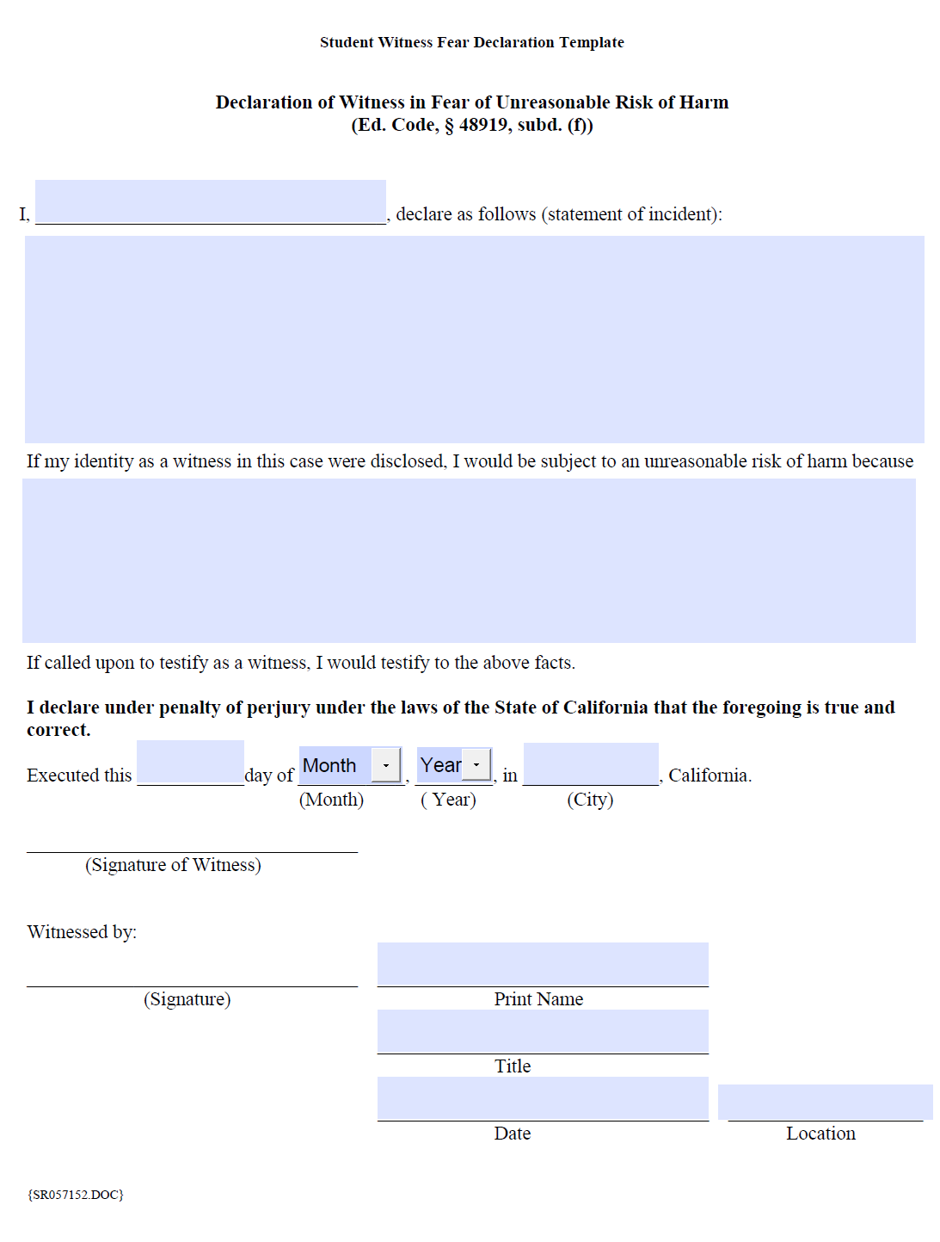
Declaration of Fear
Used when subjecting a witness to a hearing “would subject the witness to an unreasonable risk of psychological or physical harm”
Used in rape and gang cases.

Slide 11
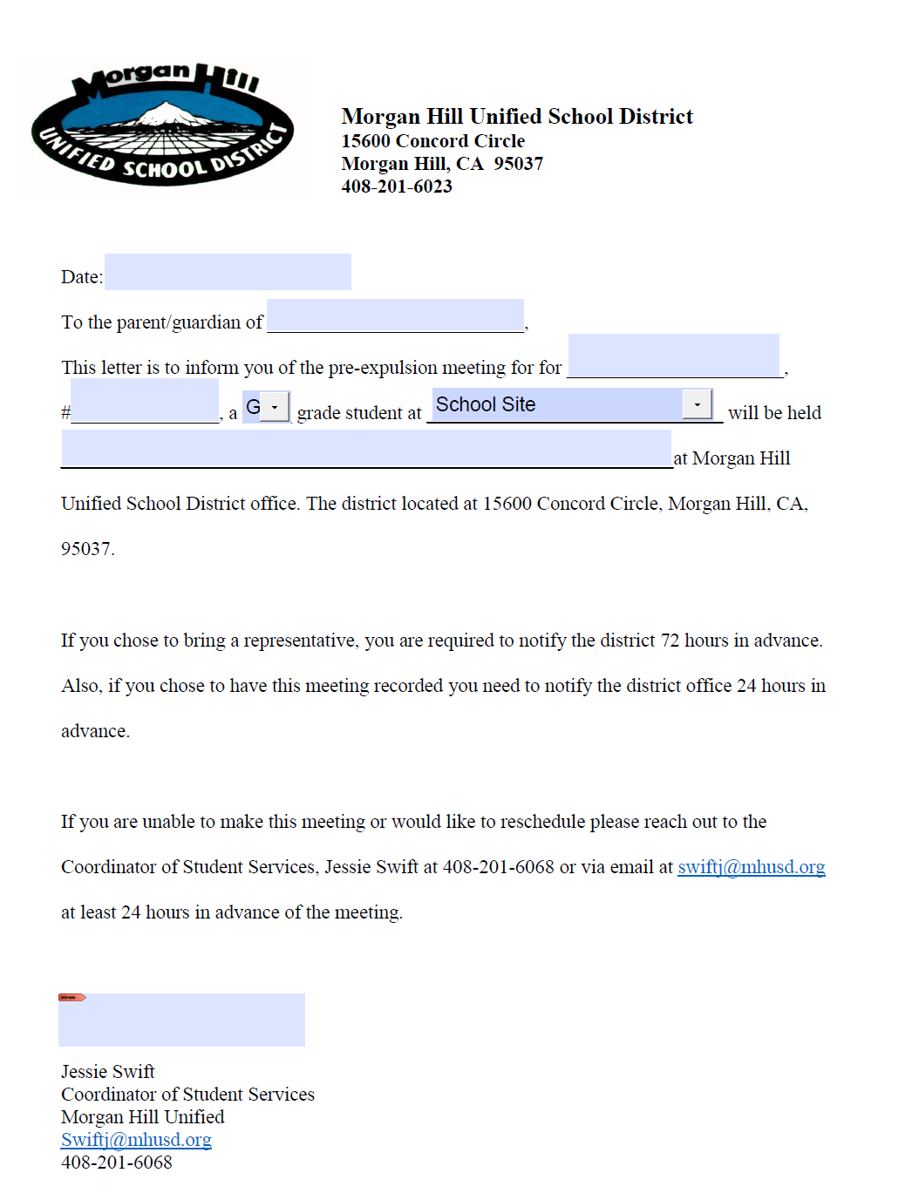
Pre-expulsion meeting
Occurs prior to an official hearing.
Purpose-
To review process and offenses
To see if the student will accepted a stipulated expulsion.
To provide the expulsion documentations and review their rights.
Pre Expulsion Meeting letter
Receipt of documents
Expulsion docs will be mailed out to panel members if hearing is determined.

Slide 12
Expulsion Hearing
Site
Student/parent
The site recommending the expulsion will present their case to the panel.
Purpose:
To show that all due process was meet (including timelines).
That the site had legal authority
The student committed an/the expellable offenses.
Danger to themselves and others.
Make recommendations for term.
To present their student’s/own side of events and to convivence the panel the site did not:
Follow due process
Have authority
Committed the offense
A danger to self or others.
The student/parent also have a right to bring their own witnesses to the hearing.
Expulsion Script (Live testimony)
Expulsion Script (no student witnesses)

Slide 13
After the hearing…
The panel meets to discuss:
IF the site was able to prove due process, authority, offense, and danger.
They will make the recommendation to the board to expel or not.
Decision is given to me…
I let the parents know and then prepare the board docs.
Present the recommendation to the board.
Board decides.
I sent home notice to parents and schools sites of decision and either release or readmit to the school site.

Slide 14
Questions?

